Slide 1
Chapter 3: Java Server Page
Jakarta EE
Notes:
https://github.com/eclipse-ee4j/jakartaee-tutorial

Slide 2
Content
3.1. Fundamentals
3.2. Implicit Objects
3.3. Standard Actions
3.4. JSTL
3.5. Expression Language

Slide 3
Fundamentals

Slide 4
Fundamentals
There are two drawbacks associated with servlets:
  all HTML tags written in a servlet must be enclosed in Java strings
  all text and HTML tags are hardcoded; as such, even minor changes to the presentation layer require recompilation
JavaServer Pages (JSP) solves the two problems in servlets.

Slide 5
Fundamentals
JSP does not replace Servlet. Modern Java web applications use both servlets and JSP pages
A complete JSP code is more like a HTML with bits of java code in it
The first time a JSP page is invoked a servlet/JSP container converts it into servlet class before processing the client’s request

Slide 6
Fundamentals
- JSP compilation into Servlets
JSP
Initial
request
Web
Browser
Web
Server
J2EE Web
Container
Java
Servlets
Subseq
request

Slide 7
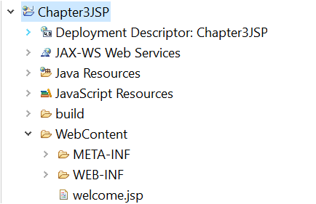
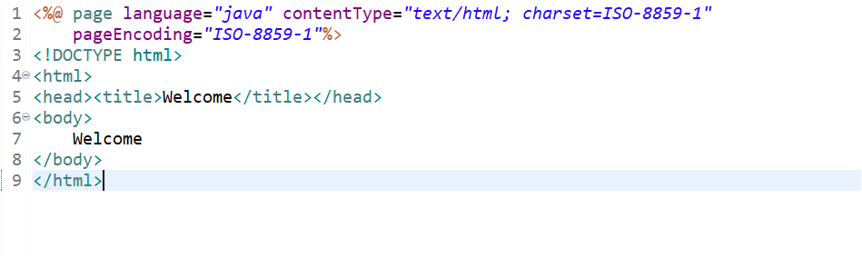

Example of JSP code

Slide 8
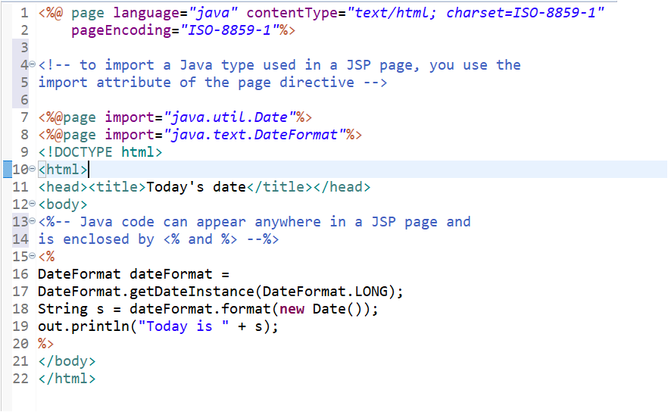
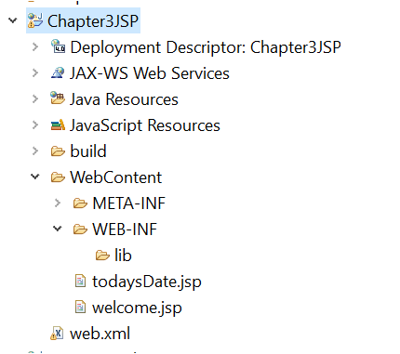


Example of JSP code

Slide 9
Comments
There are two types of comments that can appear in a JSP page:
JSP comments: <%-- comments here --%>. A JSP comment is not sent to the browser
HTML/XHTML comments: <!-- comments here -->. HTML/XHTML comment is sent to the browser

Slide 10
Implicit Objects

Slide 11
Implicit Objects
JSP Implicit Objects are also called pre-defined variables
Object | Type
request | javax.servlet.http.HttpServletRequest
response | javax.servlet.http.HttpServletResponse
out | javax.servlet.jsp.JspWriter
session | javax.servlet.http.HttpSession
application | javax.servlet.ServletContext
config | javax.servlet.ServletConfig
pageContext | javax.servlet.jsp.PageContext
page | javax.servlet.jsp.HttpJspPage
exception | java.lang.Throwable

Slide 12
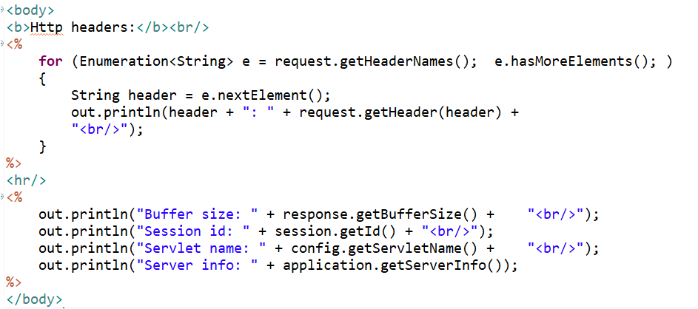
Implicit Objects

Slide 13
STANDARD Actions

Slide 14
STANDARD Actions
Actions: provides several standard action tags intended for a specific tasks such including other resource or forwarding the request to other resources or working with java bean objects..
Syntax : <jsp:action_name attribute="attribute_value" />
Directives vs Actions:
  Directives are used during translation phase while actions are used during request processing phase.
  Actions are re-evaluated each time the page is accessed

Slide 15
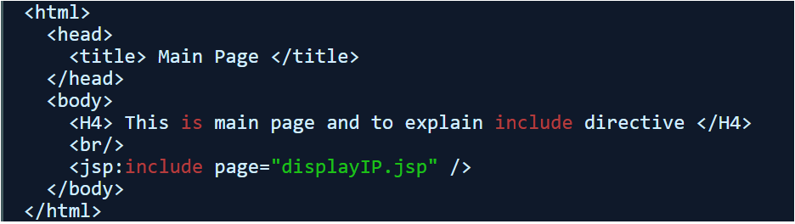
Actions - jsp:include
used to include any other resource (may be html, jsp etc) at a runtime.
Syntax: <jsp:include page="another file" />

Slide 16
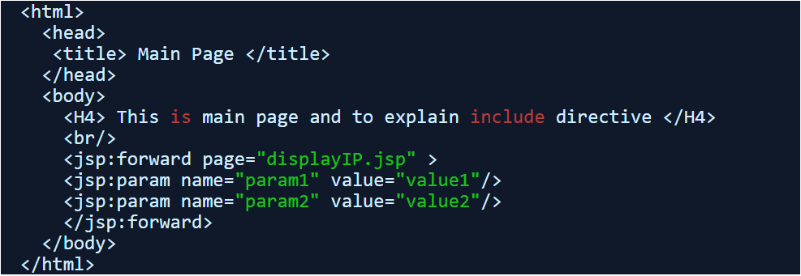
Actions - jsp:forward
used to forward request any other resource (may be html, jsp etc).
Syntax: <jsp:forward page="another file" />

Slide 17
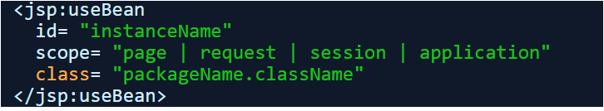
Actions - jsp:useBean
Creates a scripting variable associated with a Java object.
Syntax:

Slide 18
Actions - jsp:useBean
Example:
<!DOCTYPE html>
<html>
<head>
<title>useBean</title>
</head>
<body>
<jsp:useBean id="today" class="java.util.Date"/>
<%=today%>
</body>
</html>

Slide 19
Actions - jsp:useBean
setProperty and getProperty: The setProperty action sets a property in a Java object and getProperty prints a Java object’s property
Example: getSetPropertyTest.jsp
<html>
  <head>
  <title>getProperty and setProperty</title>
  </head>
  <body>
  <jsp:useBean id="employee" class="jspdemo.Employee"/>
  <jsp:setProperty name="employee" property="firstName" value="Abigail"/>
  First Name: <jsp:getProperty name="employee" property="firstName"/>
  </body>
</html>

Slide 20
JSTL

Slide 21
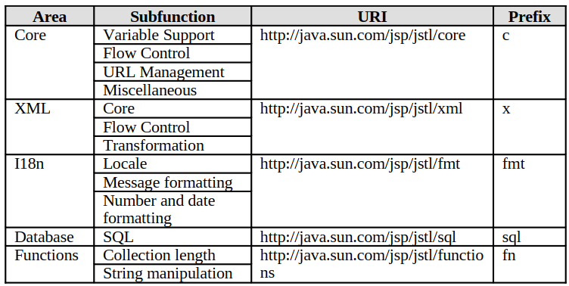
JSTL
JSTL: a collection of custom tag libraries for solving common problems such as iterating over a map or collection, conditional testing, XML processing, and even database access and data manipulation

Slide 22
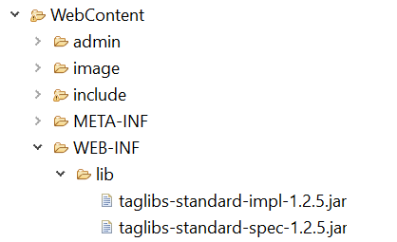
JSTL Libraries
There are two pieces of software we need to download, the JSTL API and the JSTL implementation:
  JSTL API contains the javax.servlet.jsp.jstl package, which consists of types defined in the JSTL specification
  The JSTL implementation contains the implementation classes
  We must copy both jar files to the
  WEB-INF/lib directory of every application
  utilizing JSTL

Slide 23
JSTL Libraries
To use a JSTL library in a JSP page, use the taglib directive with the following format:
    <%@ taglib prefix="prefix" uri="uri" %>
    <%@ taglib uri="http://java.sun.com/jsp/jstl/core" prefix="c" %>
    <%@ taglib prefix="fn" uri="http://java.sun.com/jsp/jstl/functions"%>
    <%@ taglib prefix="sql" uri="http://java.sun.com/jsp/jstl/sql"%>
    <%@ taglib prefix="fmt" uri="http://java.sun.com/jsp/jstl/fmt"%>
    <% taglib prefix= ="x" uri= " http://java.sun.com/jsp/jstl/xml " %>
Notes:
Book: 1_2015_Servlet and JSP (second Editionl).pdf page: 142 / 630
Example: https://www.wideskills.com/jsp/jsp-standard-tag-library-jstl

Slide 24
Expression Language

Slide 25
JSP Expression Language (EL)
Provide another convenient way to minimize the use of scripting tag in JSP
To access the data , process the data, store it in some scope in JSP
General syntax: ${expression}
Notes:
Book: 1_2015_Servlet and JSP (second Editionl).pdf page: 142 / 630
Example: https://www.wideskills.com/jsp/jsp-standard-tag-library-jstl

Slide 26
Expression Language Implicit Objects (1)
Name | Description
pageScope- | use to get the value of attribute stored in page scope
requestScope | Use to get the value of attribute stored in request scope.
sessionScope | use to get the value of attribute stored in session scope
applicationScope | use to get the value of attribute stored in application scope.
cookie | use to get the cookie value
initParam | use to get the context init params, we can’t use it for servlet init params
Notes:
Book: 1_2015_Servlet and JSP (second Editionl).pdf page: 142 / 630
Example: https://www.wideskills.com/jsp/jsp-standard-tag-library-jstl

Slide 27
Expression Language Implicit Objects (2)
Name | Description
pageContext | provides access to many objects request, session etc.
param | use to get request parameters (valid only for single value)
paramValues | use to get request parameter to an array of values
header | use to get the request header value (valid for single value)
headerValues | use to get the request header value to an array of values.

Slide 28
Expression Language Operators
Operator Type | Description
Arithmetic | + , - , / or div , * , % or mod
Logical | && , || , !
Relational | == (eq), != (ne), < (lt), > (gt), <= (le) , >= (ge)
Dot (.) Operator | Use to access property of any bean: ${bean.property_name}
[ ] operator | Use to get the data from array and list along with beans: ${myList[1]} or ${myList["1"]}

Slide 29
Expression Language Reserved Words
and, or , not, eq, ne, lt, gt, le, ge, true, false, nul, instanceof, empty, div, mod

Slide 30
Disable Expression Language
<%@ page isELIgnored ="true|false" %>

